Slide 1

UAT Testing portal Training documentation

Slide 2


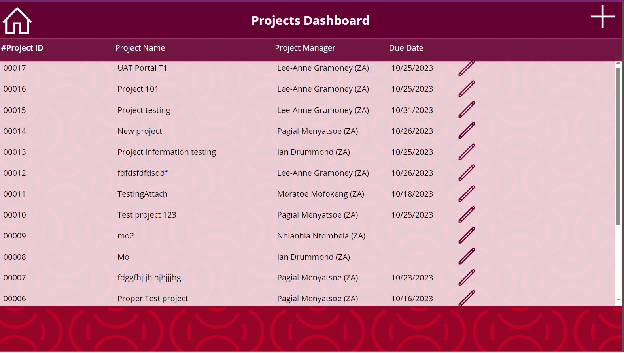
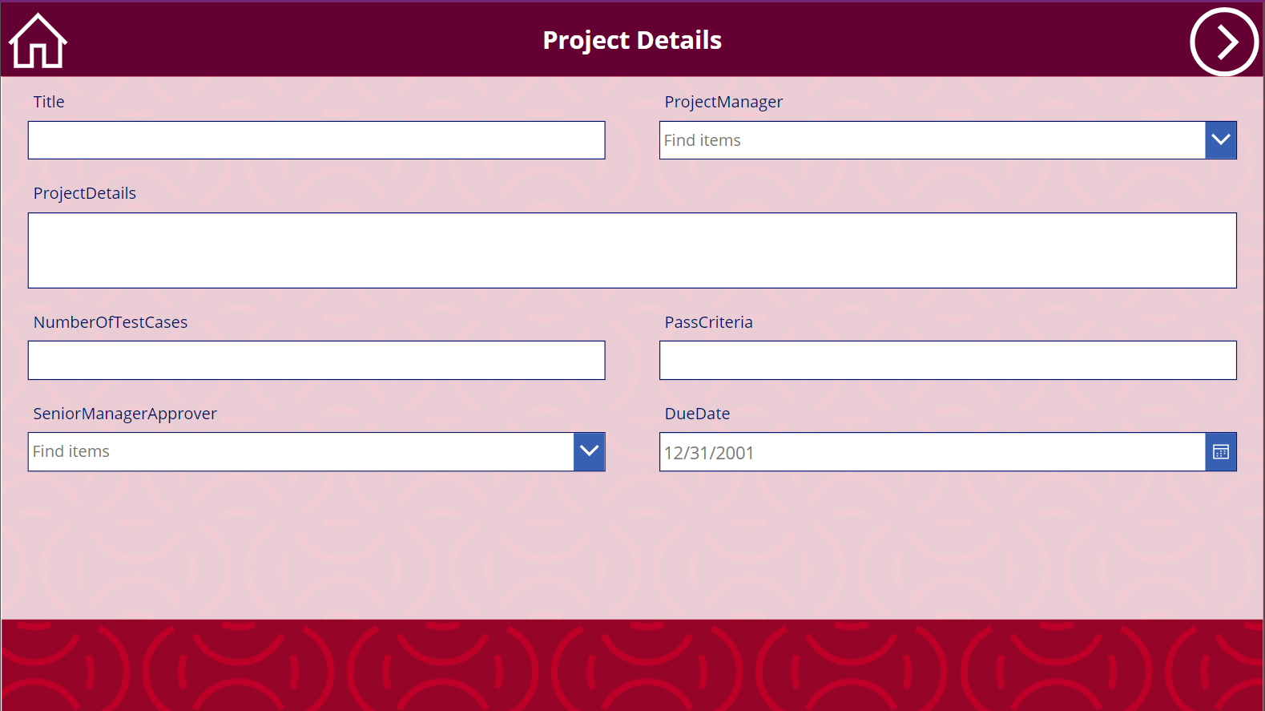
BuzTech Stars Hackathon 2023
How to capture project details
Project Manager
Open the application:
Add a new project
Capture the project Details
Capture the number of test cases
And success criteria
Choose the final approver and due date
Press Next

Slide 3
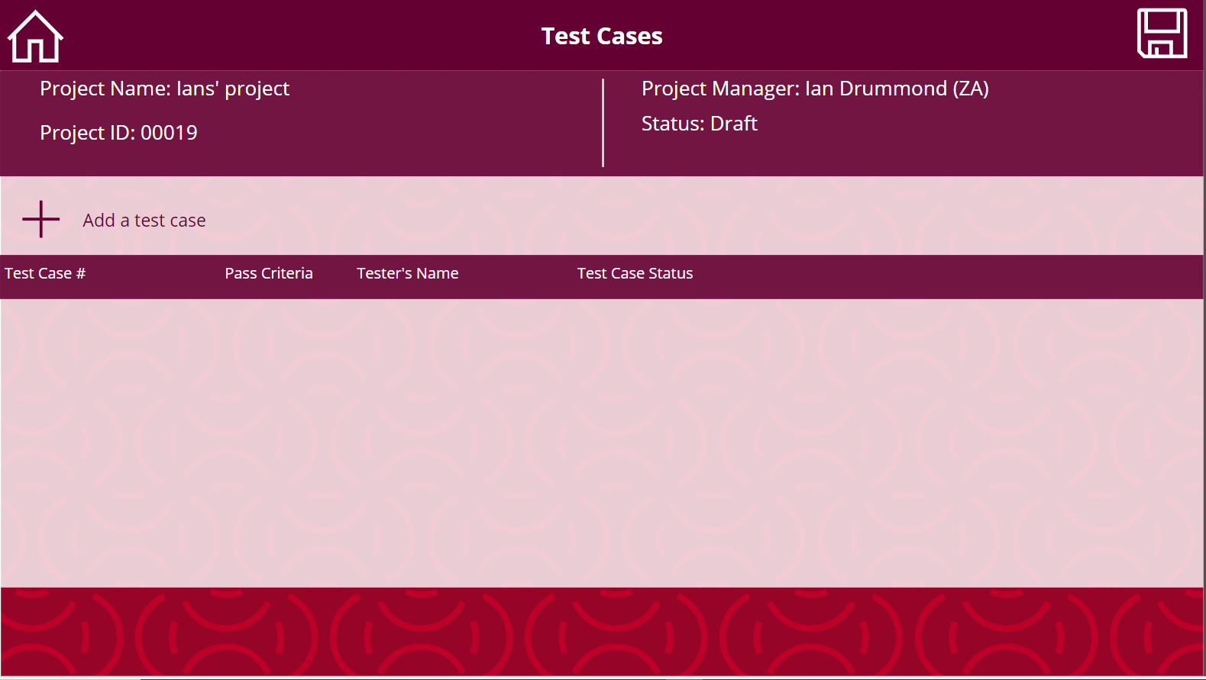
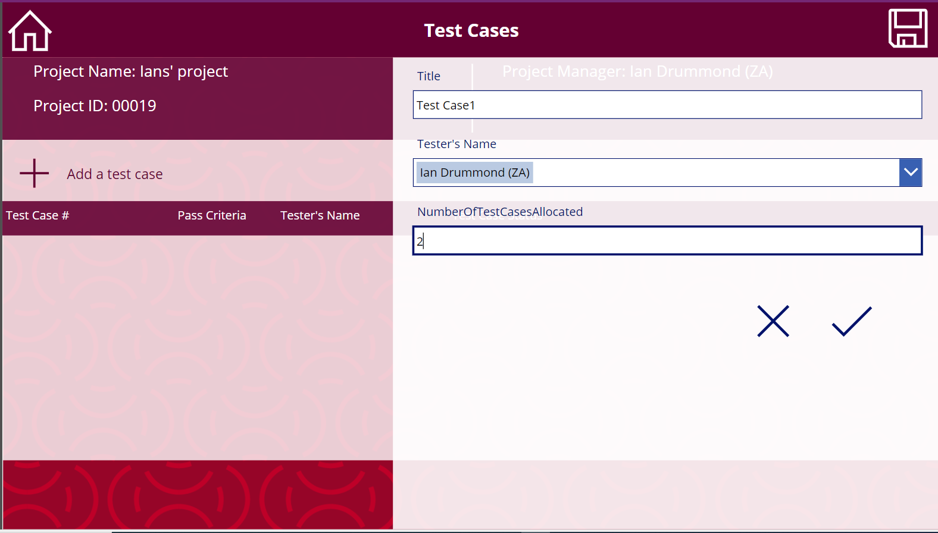
BuzTech Stars Hackathon 2023
How to capture test cases
Project Manager
Add a test case
Assign test case to a tester
Press Save

Slide 4


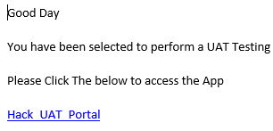
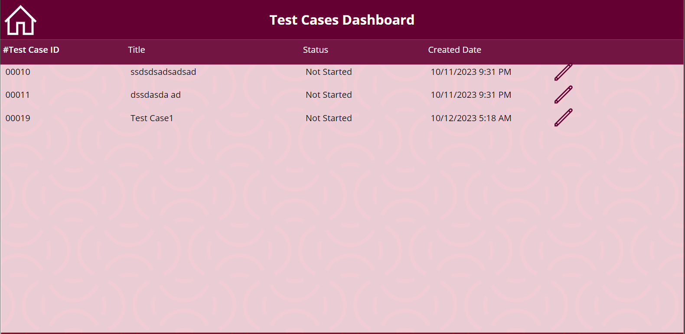
BuzTech Stars Hackathon 2023
How to get your test cases
Testers
Follow the link in your mail
Open your test case

Slide 5
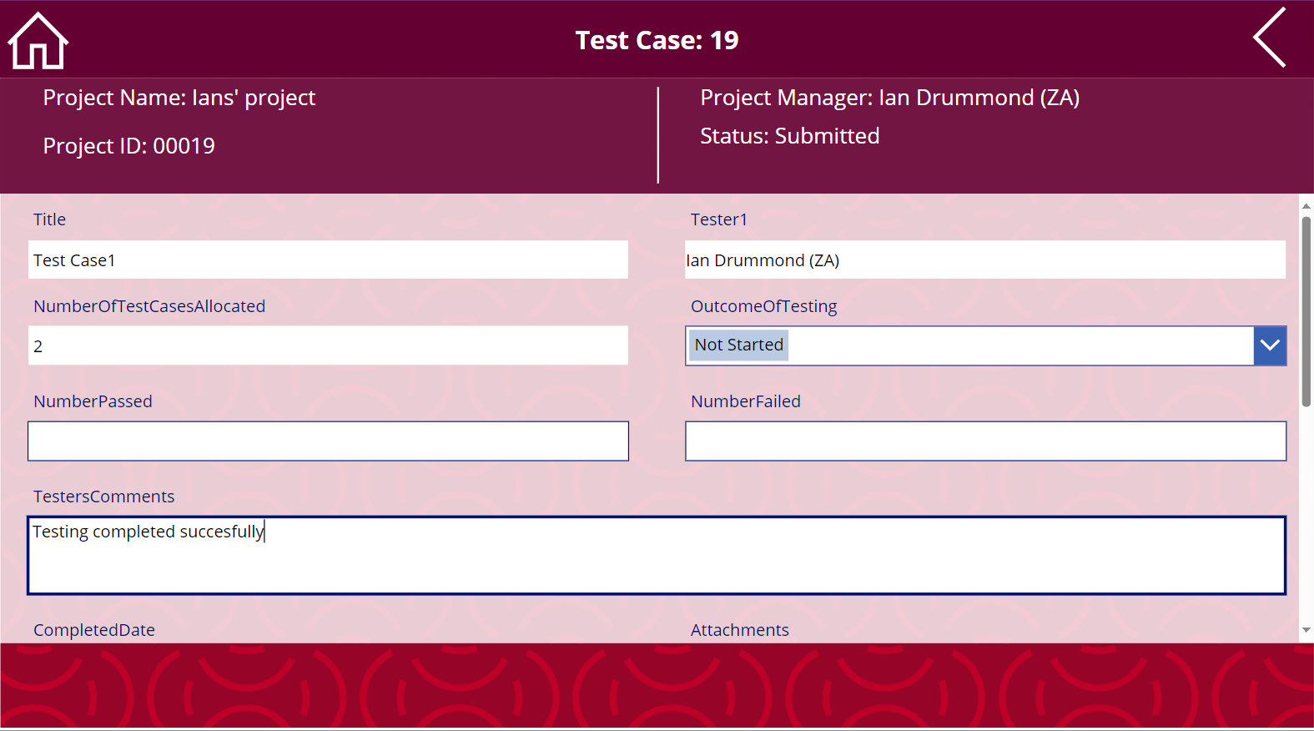
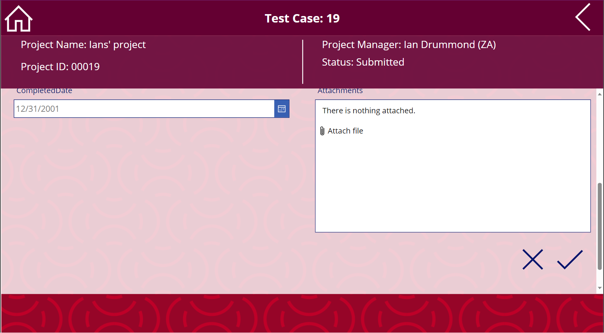
BuzTech Stars Hackathon 2023
How to upload evidence
Testers
Capture the Tet case detail
Capture overall feedback
Upload completed test case evidence
Press Submit

Slide 6


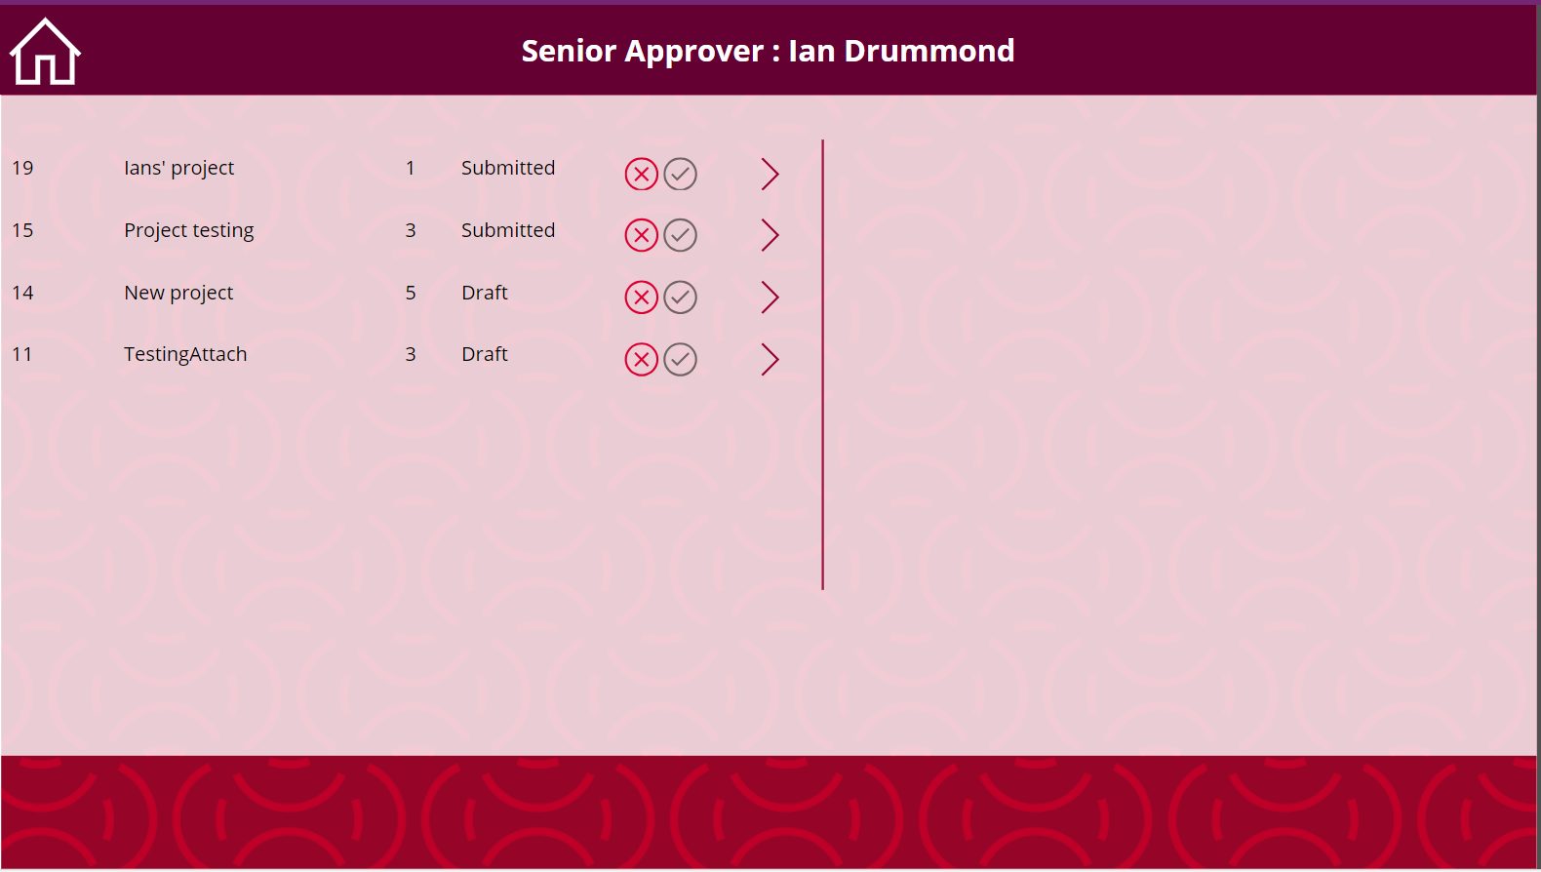
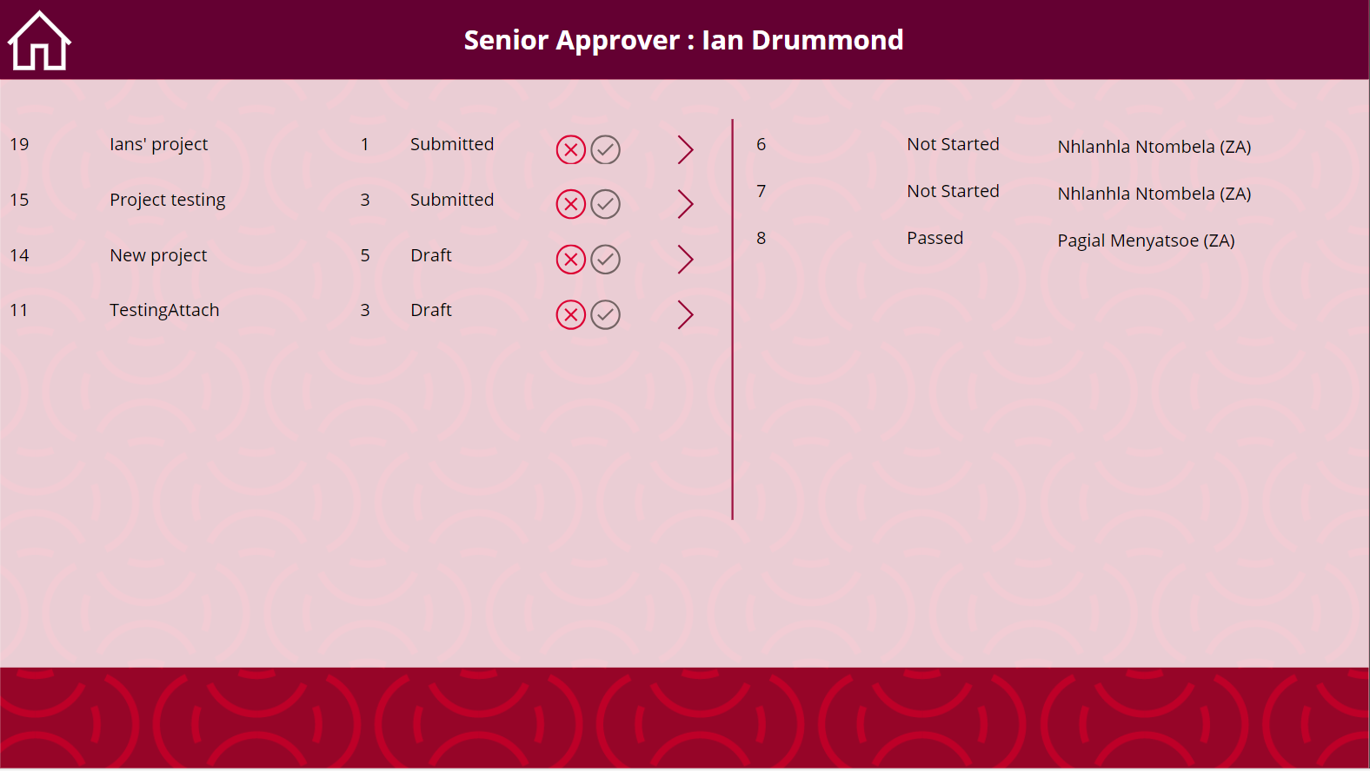
BuzTech Stars Hackathon 2023
How to capture final approval
Final Approver
Follow the link in your mail
Expand to see project detail
Select Pass or Fail

Slide 7

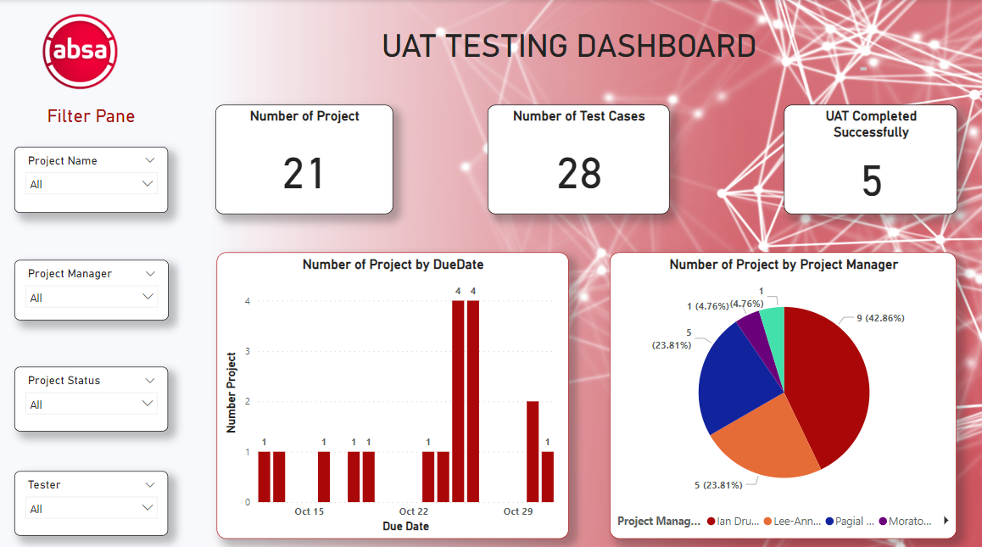
BuzTech Stars Hackathon 2023
How to View the Dashboard
Project Manager
Access the dashboard here
Filter by tester, project or status
Select values to filter

Slide 8
Thank You

